Slide 1
How are medical students trained to be doctors?

Slide 2

Medical Education Highly Relies on Feedback
Medical students are observed in their interactions with patients by supervisors (physicians)
They receive feedback forms on their interaction, performance, diagnosis, clinical reasoning, communication, professionalism… among other things

Slide 3
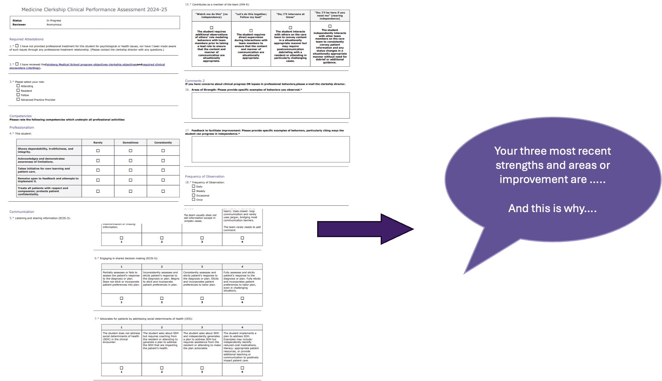
Medical Education Highly Relies on Feedback
Medical students are observed in their interactions with patients by supervisors (physicians)
They receive feedback forms on their interaction, performance, diagnosis, clinical reasoning, communication, professionalism… among other things
Feedback forms at NW are called Clinical Assessment Forms (CPAs)
Filled out by different evaluators
Across different rotations
Text, numeric, Likert scale
Subjective and Difficult to Interpret

Slide 4
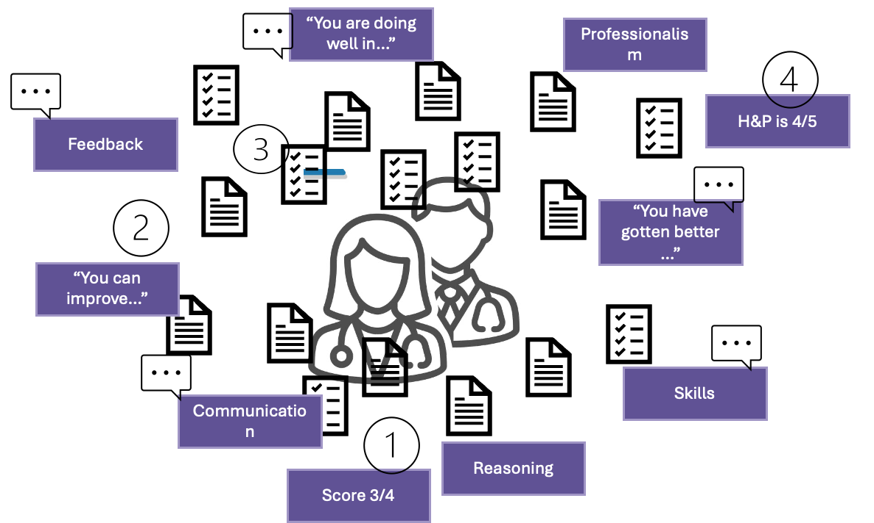
The amount of feedback can be overwhelming, confusing and difficult to act on

Slide 5
Problem
Medical students receive feedback from multiple evaluators in varying formats (numeric vs text) across different settings, making it difficult to identify performance trends, strengths, and improvement areas.

Slide 6
Student Feedback Analyzer
Turning student feedback forms into actionable insights on student performance and growth
Zelin Li
Weihao He
Paola Barrios
Notes:
The name of the system.
A description of the problem that you were addressing.
An outline of the solution.
A demo of the system in action.
A description of the system at an architectural level.
A discussion of any problems that you encountered and how you over came them.
A discussion of future work.

Slide 7
Initial Important Features
Identifies trends over time
Does not prioritize more vs less experienced physician feedback
Integrates numeric scores with text

Slide 8

I wonder what I can get better at?
nucpa-MACAS

Slide 9
Architecture
Multi-Agent System
Data Ingestion Agent
Student Query
Query Understanding Agent
Orchestrator
Response Generation Agent
Consolidation Agent
All available feedback forms of that student
Numeric Analysis Agent
Numeric scores
Text
Final Response Back to Student
Free Text
Agent

Slide 10
Challenges
Solution
Agent Must Cite Evidence for its Response
Passing summary from text rather than quote itself
Temporal Priorities: More recent feedback better reflection of current performance than earlier feedback
Weighting based on date
Pattern Recognition and Confidence
Triangulation based on multiple evaluators, across time to identify established pattern

Slide 11
Future Work
Client Happy!
Show platform to students to test proof of concept
Adapt to further client feedback based on their findings while exploring the platform

